Slide 1



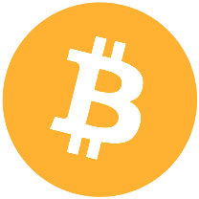
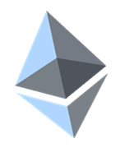

Cryptocurrency Exchanges
Platforms for Trading Cryptocurrencies
Ilin Kazandzhiev
Technical Writer
Academy School of Blockchain
http://kingsland.academy

Slide 2
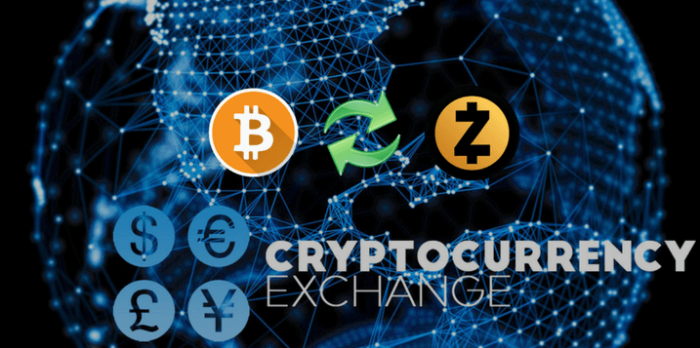
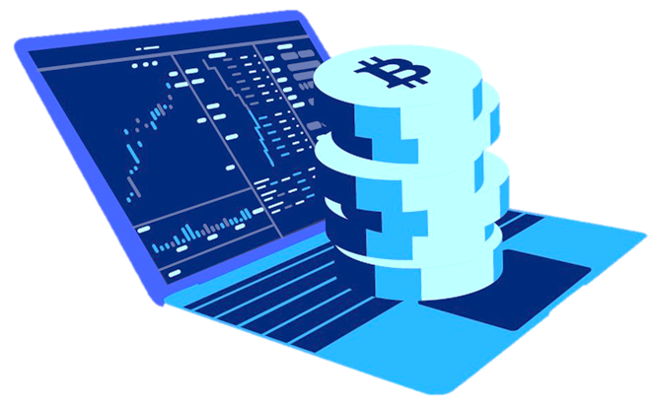

Table of Content
Altcoins
Platforms for Buying Cryptocurrency
Exchanges for Trading Cryptocurrency

Slide 3
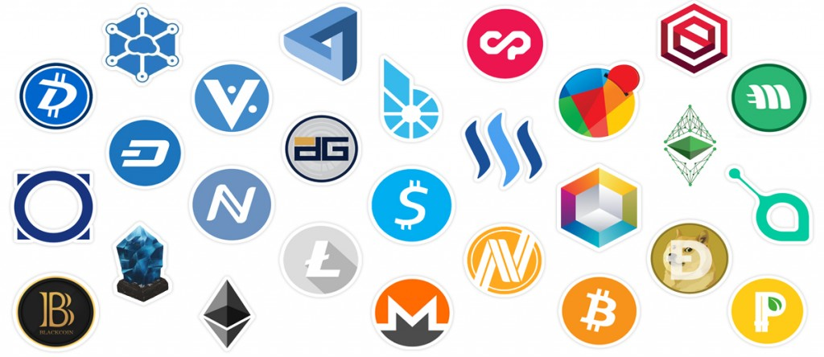
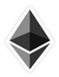
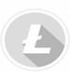
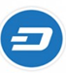


Altcoins Concept
Combination of two words: “alt” and “coin”
Alt is short for alternative and coin
Examples
Ethereum
Litecoin
DASH
Monero
Steem
Notes:
A combination of two words: “alt” and “coin”. Alt is short for alternative and coin
Together they imply a category of cryptocurrency alternative to Bitcoin itself
Many of the altcoins are built up on the basic framework provided by Bitcoin

Slide 4
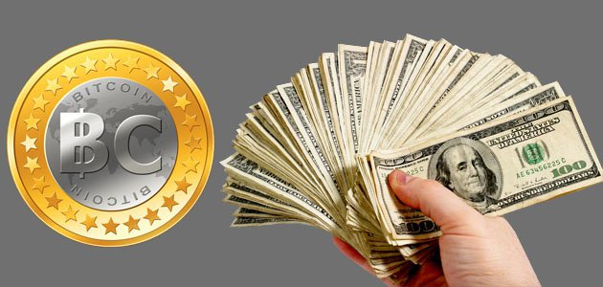
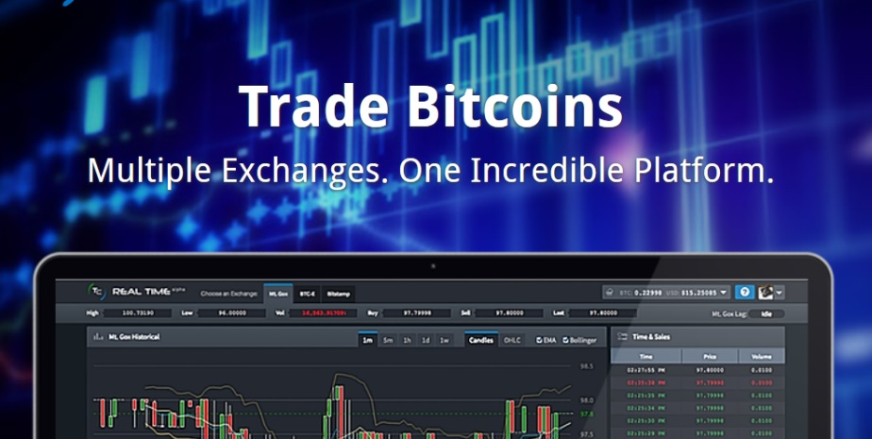
Cryptocurrency Exchanges
Examples of platforms for buying / selling Bitcoins / altcoins for fiat money
Coinbase – coinbase.com
Bitpanda – bitpanda.com
Examples of exchanges for trading
Bittrex – bittrex.com
Kraken – kraken.com

Slide 5
Steps to Buy and Trade Bitcoin
Create a cryptocurrency wallet
E.g. hardware wallet or desktop / mobile software wallet
Buy Bitcoins / altcoins into your wallet
E.g. from Coinbase, Bitpanda, ShapeShift (inside the wallet), etc.
Trade Bitcoins / altcoins
Send some amount to an exchange such as Bittrex, Kraken, etc.
Trade the coins inside your exchange account
Transfer back your coins into your personal wallet
Notes:
Three steps to buy and trade altcoins on an exchange
Buy Bitcoin from Coinbase, Bitpanda, etc.
Send the Bitcoin to exchange such as Bittrex, Kraken, etc.
Trade Bitcoin for Ripple for example.
Use the BTC/XRP (Bitcoin to Ripple) pair to buy XRP
There are different trading pairs but most common are BTC, LTC and ETH trading pairs

Slide 6
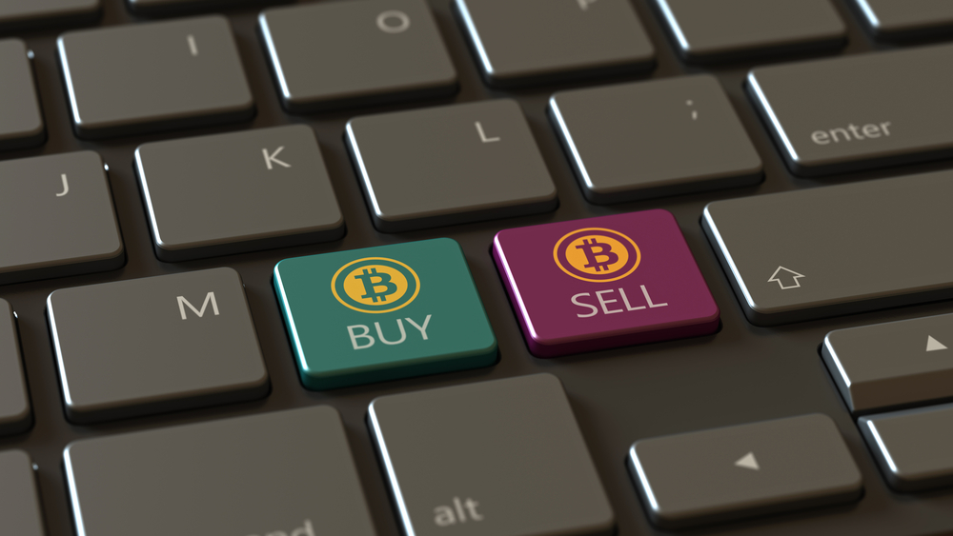
Cryptocurrency Buying Platforms

Slide 7
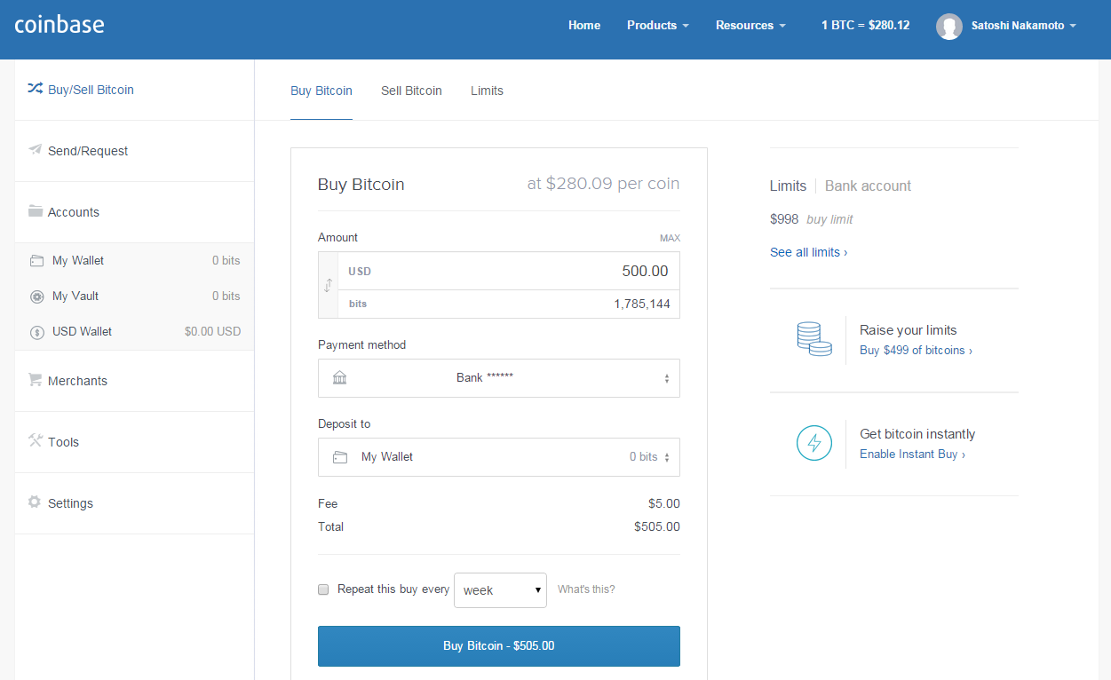
Coinbase

Slide 8
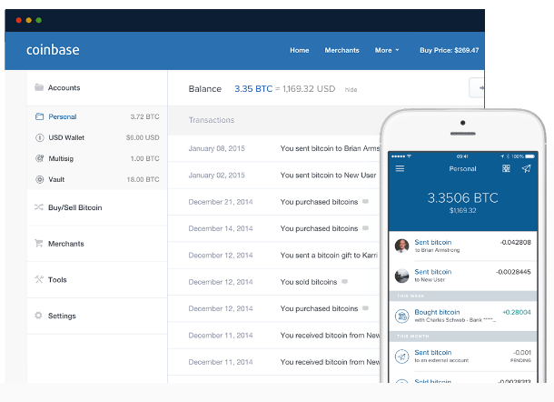
About Coinbase
There is a small fee for exchanging cryptocurrencies
Coinbase is US based
Required to comply with US law
Considered as one of the most secure platforms
Coinbase operates the GDAX exchange (for professional traders)
Notes:
Coinbase operates with local banks in 32 different countries
There is a small fee for exchanging crypto
Sending and receiving bitcoin is free
Coinbase is considered one of the most secure platforms
Coinbase is US based and is required to comply with US law
Coinbase operates the GDAX exchange, which is intended to focus on professional traders

Slide 9
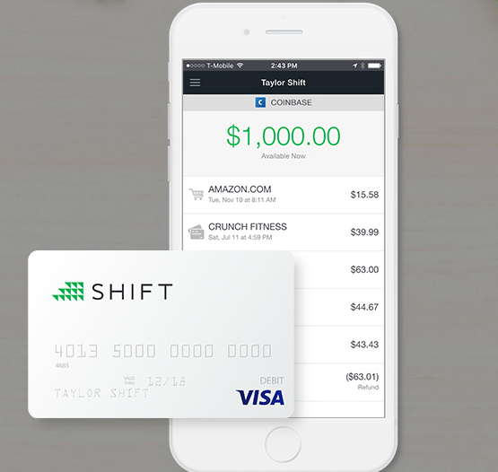
Coinbase: Pros
Excellent Reputation
FDIC Insured
Easy to Use
Very Secure
Accepts Credit / Debit Cards

Slide 10
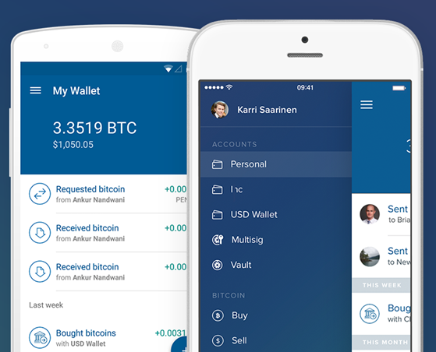
Coinbase: Cons
Slow Customer Support
Limited Currencies Available

Slide 11
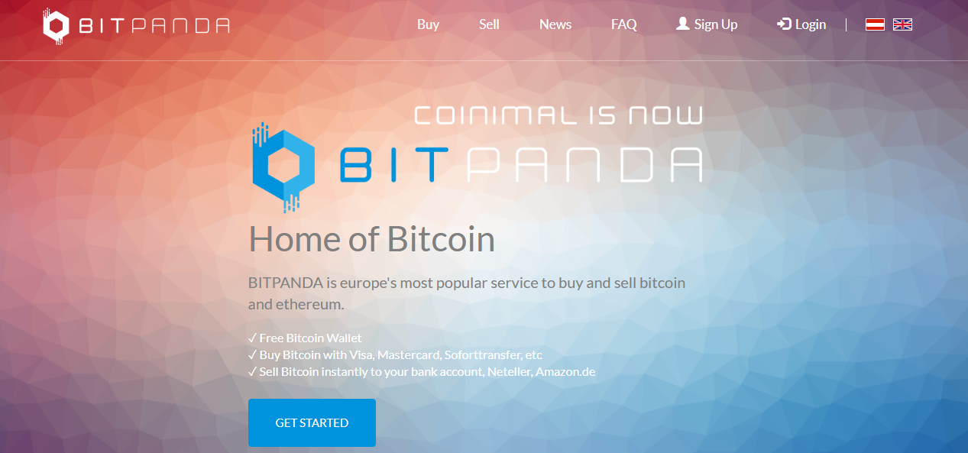
BitPanda

Slide 12
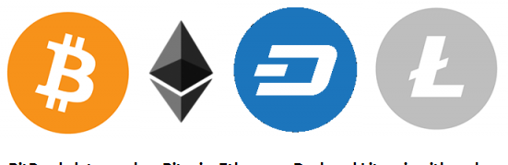
About BitPanda
4 integrated online wallets
Easy buying and selling Bitcoin, Litecoin, Ethereum and Dash
One of the most popular options to purchase Bitcoins around Europe
Notes:
Web-based with 4 integrated online wallets
Easy buying and selling Bitcoin, Litecoin, Ethereum and Dash
The user interface of BitPanda is pretty sleek and intuitive
One of the most popular options to purchase Bitcoins around Europe

Slide 13
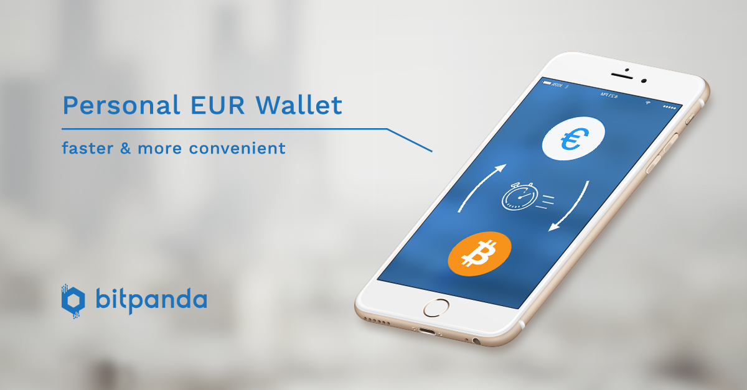
BitPanda: Pros
Wide variety of payment options
Relatively low fees
Beginner friendly
Accepts Credit / Debit Cards

Slide 14

BitPanda: Cons
Not available Worldwide
Fees are not stated explicitly

Slide 15

Cryptocurrency Exchange Platforms

Slide 16
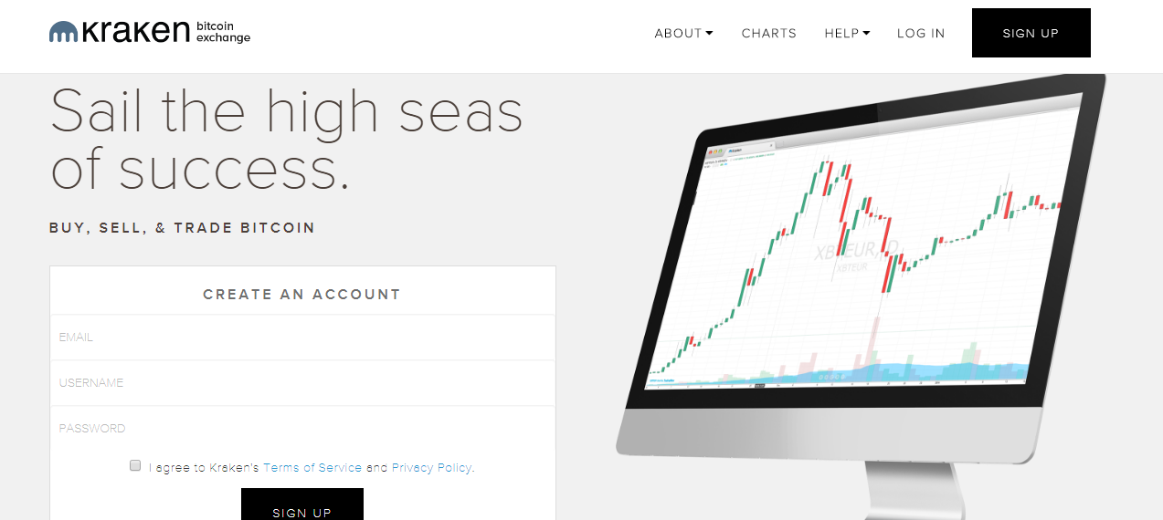
Kraken

Slide 17

About Kraken
Bitcoin margin trading
iOS mobile app for trading
Leveraged trading up to 5x
Security with 2FA and encryption
Trading tools provide a more robust functionality

Slide 18

Kraken: Pros & Cons
Pros
Beginner friendliness
Low fees
Payment methods
Cons
Customer support

Slide 19
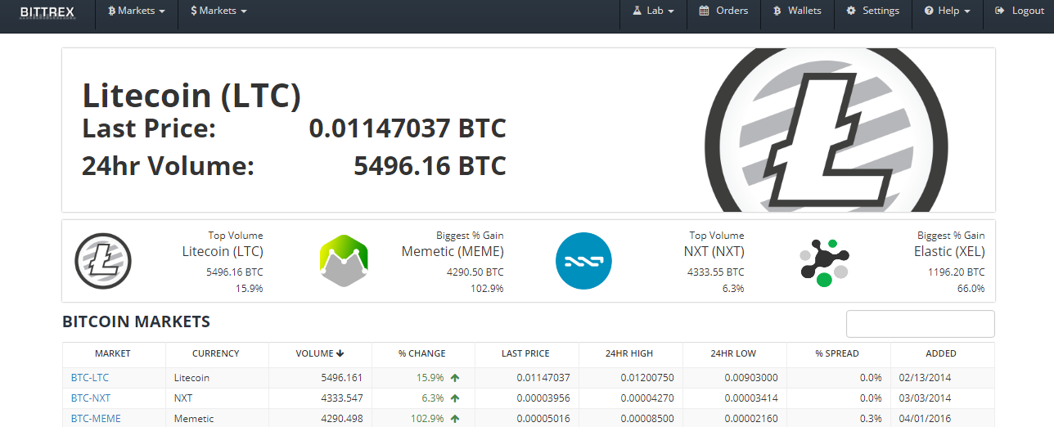
Bittrex

Slide 20

About Bittrex
Biggest crypto exchange
Bitcoin, Litecoin, Ethereum and USDT markets
Multi wallets for 250+ altcoins
Bittrex is not so beginner friendly
Mobile app is not available

Slide 21
Bittrex: Pros & Cons
Pros
250+ Trading Pairs
Better customer support than Poloniex
Easy to achieve basic account verification
Cons
No fiat trading available

Slide 22
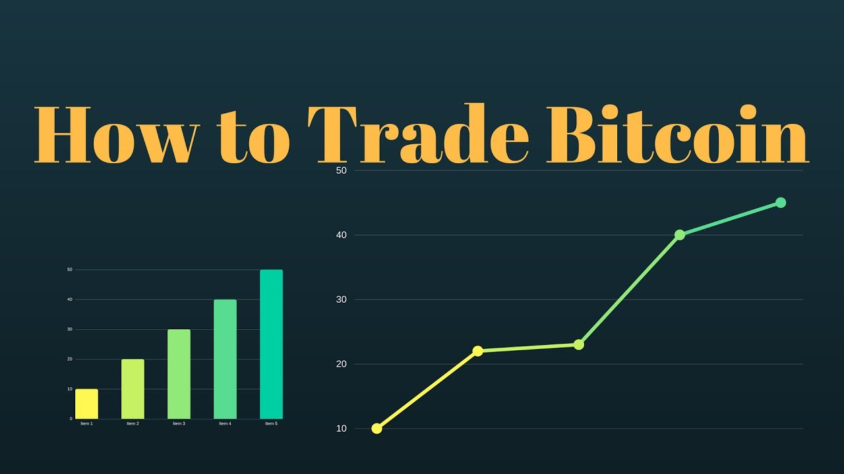
Trading on Bittrex
Exercises

Slide 23
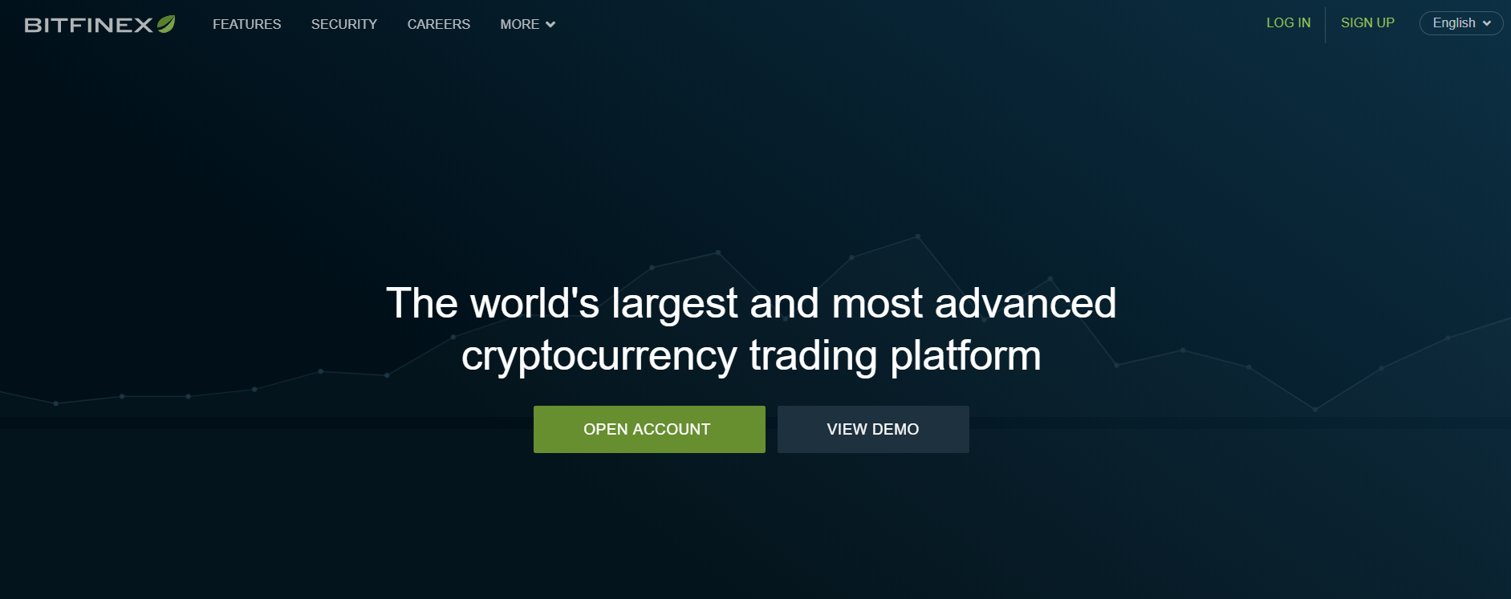
Bitfinex

Slide 24

About Bitfinex
Exchange
Margin Trading
Margin Funding
Order Types
Customizable Interface
Security
Advanced Chart Tools
Visualize your orders, positions, and price alerts
Drag to change price
Tap to modify order properties
See your position profits

Slide 25
Steps to Buy and Trade Bitcoin
Create a cryptocurrency wallet
E.g. hardware wallet or desktop / mobile software wallet
Buy Bitcoins / altcoins into your wallet
E.g. from Coinbase, Bitpanda, ShapeShift (inside the wallet), etc.
Trade Bitcoins / altcoins
Send some amount to an exchange such as Bittrex, Kraken, etc.
Trade the coins inside your exchange account
Transfer back your coins into your personal wallet
Notes:
Three steps to buy and trade altcoins on an exchange
Buy Bitcoin from Coinbase, Bitpanda, etc.
Send the Bitcoin to exchange such as Bittrex, Kraken, etc.
Trade Bitcoin for Ripple for example.
Use the BTC/XRP (Bitcoin to Ripple) pair to buy XRP
There are different trading pairs but most common are BTC, LTC and ETH trading pairs

Slide 26

Exercises
How to trade on Bittrex

Slide 27
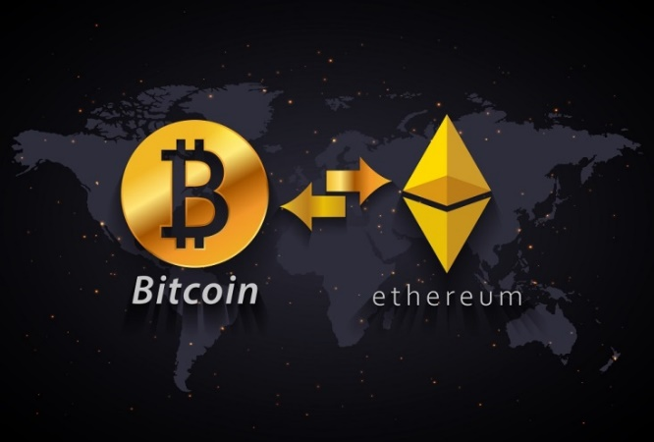
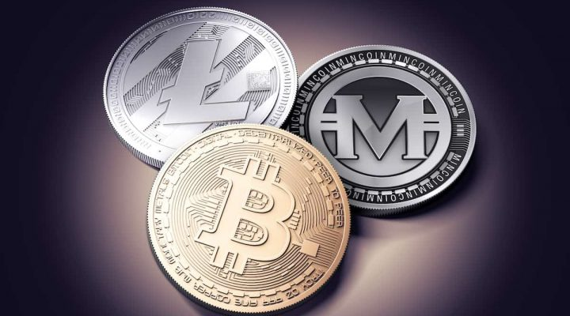
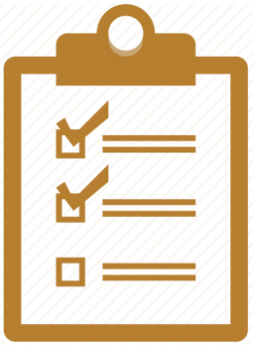
Summary
Buying cryptocurrencies for fiat money requires a credit card / wire transfer + identity verification (usually)
Selling cryptocurrencies for fiat money requires a IBAN (for wire transfer) + identity verification (sometimes)
Trading is performed at trading platforms like Bittrex / Kraken / Bitfinex

Slide 28
Cryptocurrency Exchanges
http://www.kingsland.academy

Slide 29
Resources
https://coinmarketcap.com
https://en.bitcoin.it/wiki/Altcoin
https://coincentral.com
https://www.bitpanda.com
https://www.coinbase.com
https://bittrex.com/Home/Markets
https://www.kraken.com

